Slide 1
How to Create and Detect a Key logger

Slide 2
Introduction

Slide 3
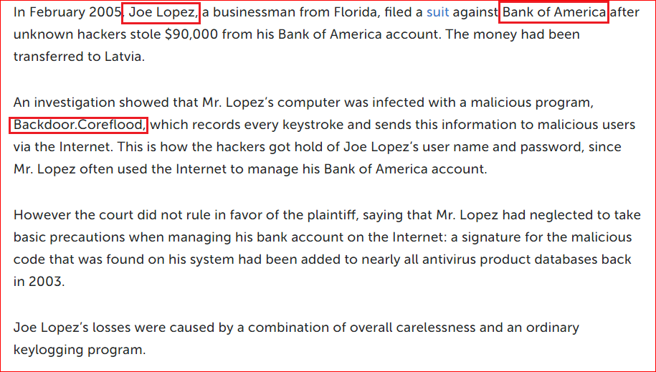
Case study: Bank of America vs. Joe Lopez
https://securelist.com/keyloggers-how-they-work-and-how-to-detect-them-part-1/36138/

Slide 4
What is key logger?
Keystroke logging
keylogging or keyboard capturing,
the action of recording the keys struck on a keyboard
Person using the keyboard is unaware that their actions are being monitored.
Data can then be retrieved by the person operating the logging program.
A keylogger can be either software or hardware.

Slide 5
Create key logger

Slide 6
Install visual studio
http://www.bowneconsultingcontent.com/pub/EH/proj/cloud/ED301c_tkp/visual_studio.htm

Slide 7
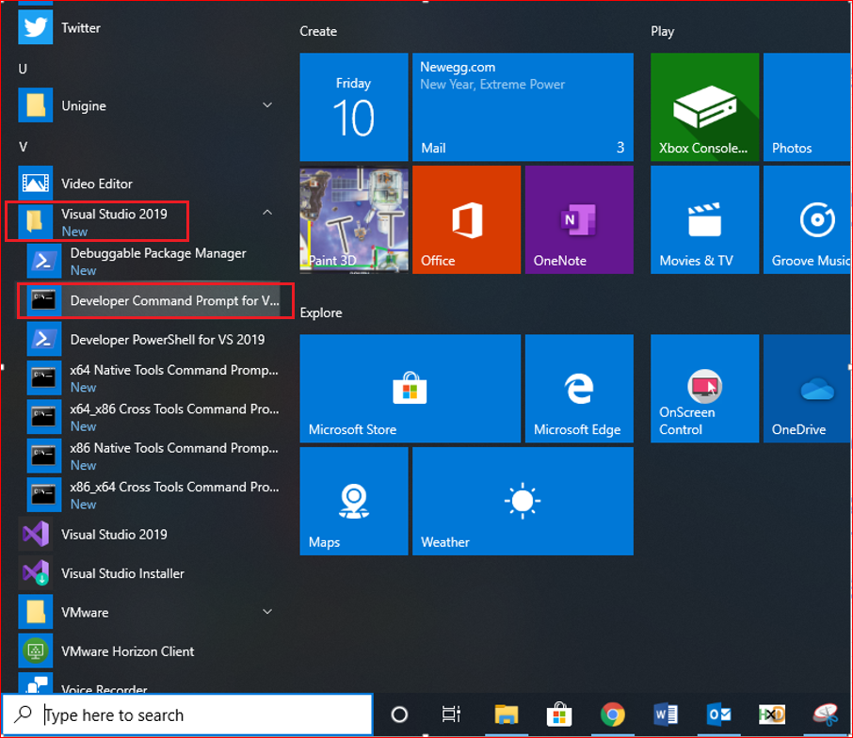
Launch VS

Slide 8
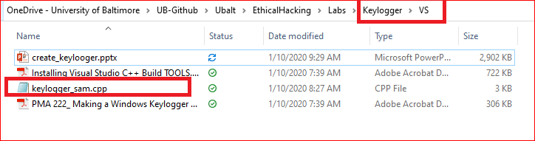
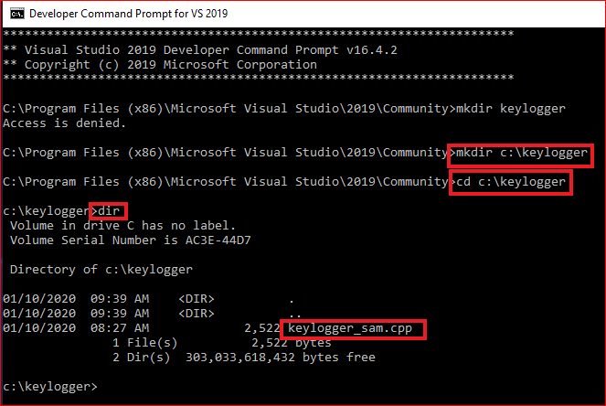
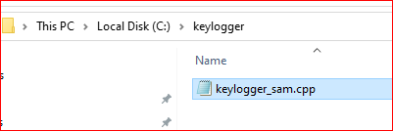
Copy .cpp file

Slide 9
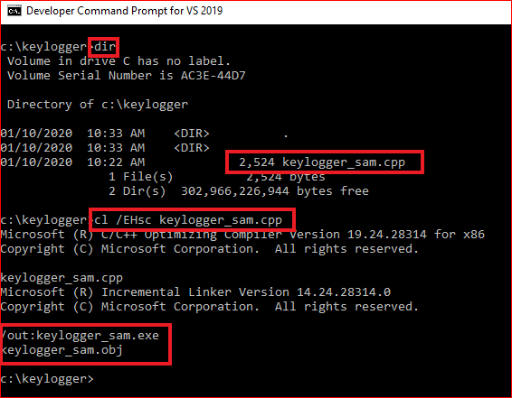
Compile the keylogger
cl /EHsc keylogger_sam.cpp

Slide 10
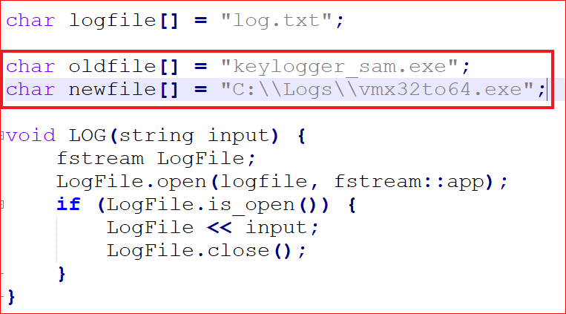
Hide key logger

Slide 11
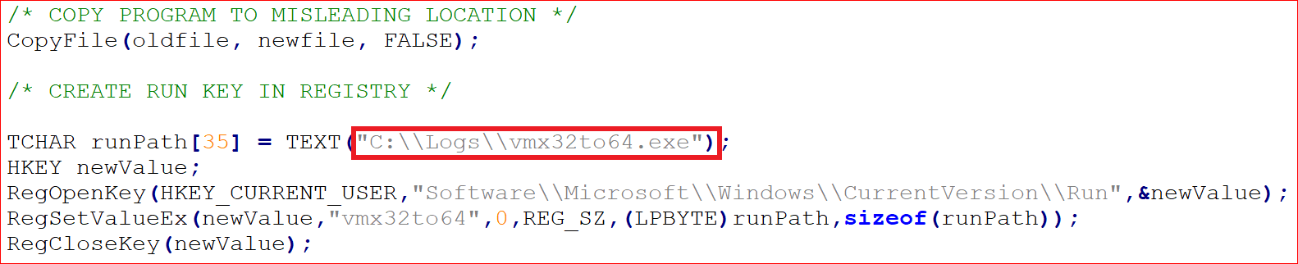
Copy and create registry key

Slide 12
Detect Key logger

Slide 13
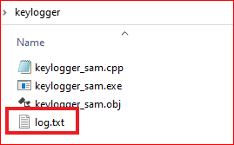
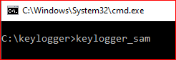
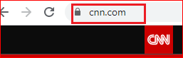
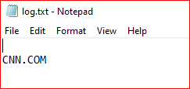
Run keylogger

Slide 14
Check evidence
Where to check the copy of the key logger?

Slide 15
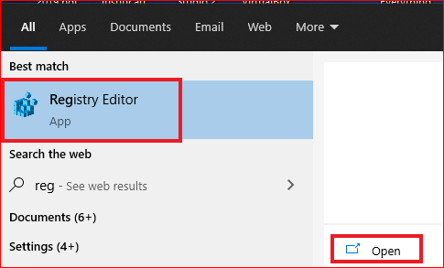
Check evidence in registry

Slide 16
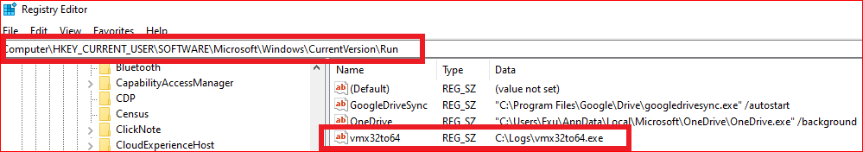

Slide 17
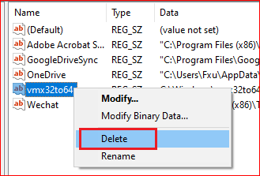
Clean it up

Slide 18
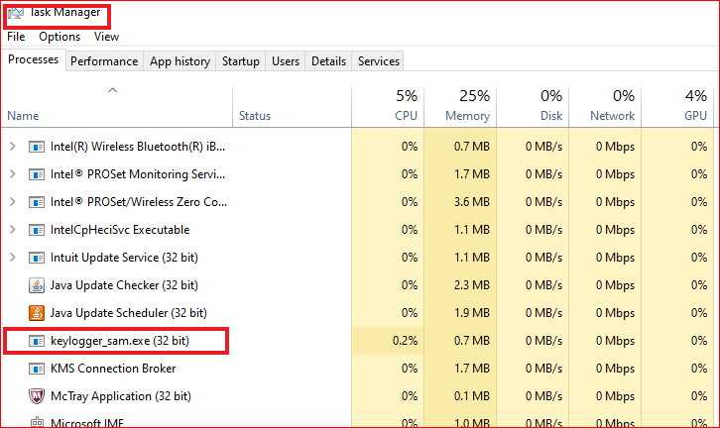
Clean it up

Slide 19
Link
http://www.bowneconsultingcontent.com/pub/EH/proj/cloud/ED301c_tkp/visual_studio.htm
https://bowneconsultingcontent.com/pub/PMA/pma221/PMA222.htm
https://docs.microsoft.com/en-us/cpp/windows/walkthrough-creating-a-standard-cpp-program-cpp?view=vs-2019

